Slide 1
Street Crossing Aid For Visually Impaired By Using CNN
Presented by
G.Pavithra
K.Sivasakthi
C.Gayathiri
GUIDE
DR.M.VENKATESAN
HOD OF CSE
NIT PUDUCHERRY

Slide 2
Smart Street Crossing Aid
An AI-powered real-time guidance system using YOLOv10 and CNN to help visually impaired individuals cross streets safely and Independently
Technologies:
YOLOv10
CNN
PyTorch
gTTS(Google Text-to-Speech)

Slide 3
System Overview & Dataset
System Flow:
Camera → YOLOv10: Detect traffic lights, vehicles, pedestrians
CNN: Predict direction (angle + midline path points)
gTTS: Convert output to audio
Dataset:
YOLOv10: VisDrone + Custom dataset (small object focus)
CNN: Cropped traffic images + CSV (angle, start/end coordinates)
Labels Used: Car, Pedestrian, Traffic Light, Direction Angle, Start & End Points

Slide 4
Model Architecture & Training
YOLOv10
Handles small object detection
Outputs bounding boxes + class labels
CNN MODEL
Input:Cropped image patches
Output:Direction angle+start & end points
CNN/ResNet-based model
TRAINING DETAILS
Framework:PyTorch
Loss:MSE+Angle error+Classification loss
Optimizer:Adam
Data Augmentations:Flip,Rotate,Resize

Slide 5
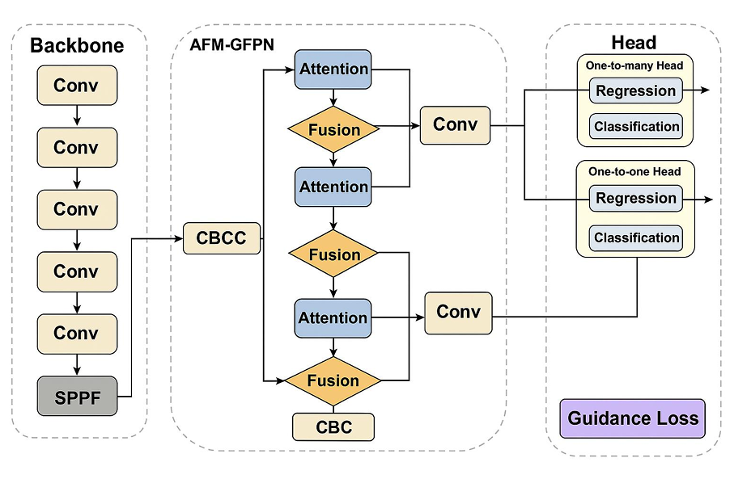
YOLOv10-Architecture

Slide 6
WORK FLOW SUMMARY
MODEL | ROLE
Backbone | Extracts low-to-high-level image features
AFM-GFPN | Enhances and merges features via attention
Head | Predicts bounding boxes+class per object
Guidance Loss | Guides model training to align with navigation logic
REQUIREMENT | HOW THIS MODEL SUPPORTS IT
Detect small & distant traffic lights | Multi-scale fusion+attention(AFM-GFPN)
Handle overlapping vehicles | One-to-many head for dense object detection
Understant spatial layout(zebra) | Fusion layers+attention focus ground-level info
Give decision(go/stop/wait) | Custom loss+logic based on prediction branches

Slide 7
Results, Accuracy & Audio Output
Detection Results:
High accuracy in small object detection
mAP@50 for YOLOv10: ~89%
CNN Model:
Accuracy: ~93%
Angle Error: ~0.99°
Start/End Point Error: ~4.68/11.48
Audio Feedback (gTTS):
“Wait – traffic light is red” “vehicle detect– wait” “Green-Go”

Slide 8
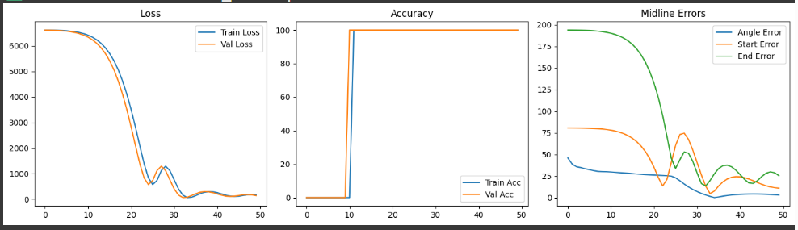
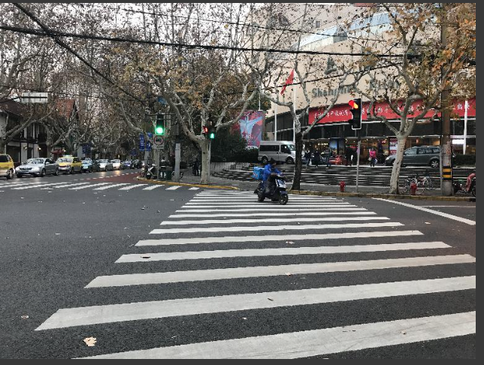
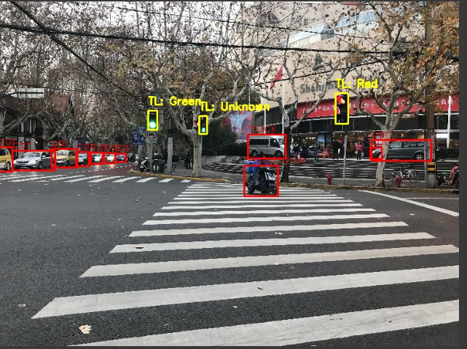

Slide 9
Conclusion
A smart, accessible system improving independence and safety for visually impaired users.
Future Improvements:
Add GPS for navigation
Obstacle detection
Multi-language support

Slide 10
THANK YOU

